Slide 1
Green LIME
Improving AI Explainability through Design of Experiments
26. 02. 2026
IIT Madras

Slide 2
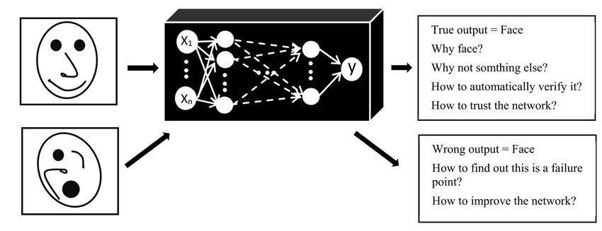
Why Explainability is Needed in AI?
Modern AI models are complex black boxes.
We cannot understand:
Why a prediction was made
Which features influenced it
Why this matters?
Trust requires explainability.
For example, in following fields we need explanation of certain prediction:
Healthcare
Finance
Legal systems

Slide 3



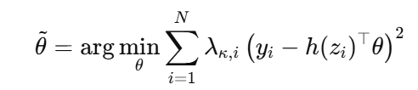
Primary Model vs Secondary Model
1. Primary Model (The "Black-Box")
Definition: A complex machine learning model whose reasoning exceeds human understanding and requires explanation.
Mathematical Function:
Scope & Nature: Operates on the global model domain; the functional form and prediction surface of fff are typically unknown.
2. Secondary Model (The Interpretable Surrogate)
Definition: A simple, interpretable model used to approximate the primary model locally.
Mathematical Function:
Optimization (Weighted Least Squares):
Scope & Nature: Model-agnostic, operates locally around x_0; common types include linear regression and decision trees.

Slide 4
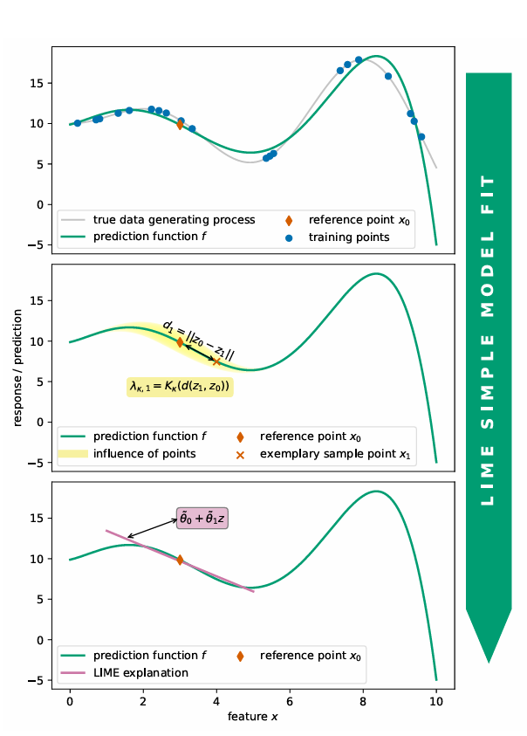
Overview of LIME
Model-Agnostic Framework: LIME explains individual predictions by fitting an interpretable secondary model (e.g., linear regression) to a complex primary model’s output at the instance level.
Kernel-Based Locality: It employs a kernel function (defaulting to RBF) and distance metrics to weight samples, ensuring the surrogate model maintains high local fidelity to the reference instance.
Stability & Efficiency Limitations: Standard random sampling often leads to result instability (variability across runs) and high energy consumption due to evaluating numerous irrelevant points with low locality weights

Slide 5
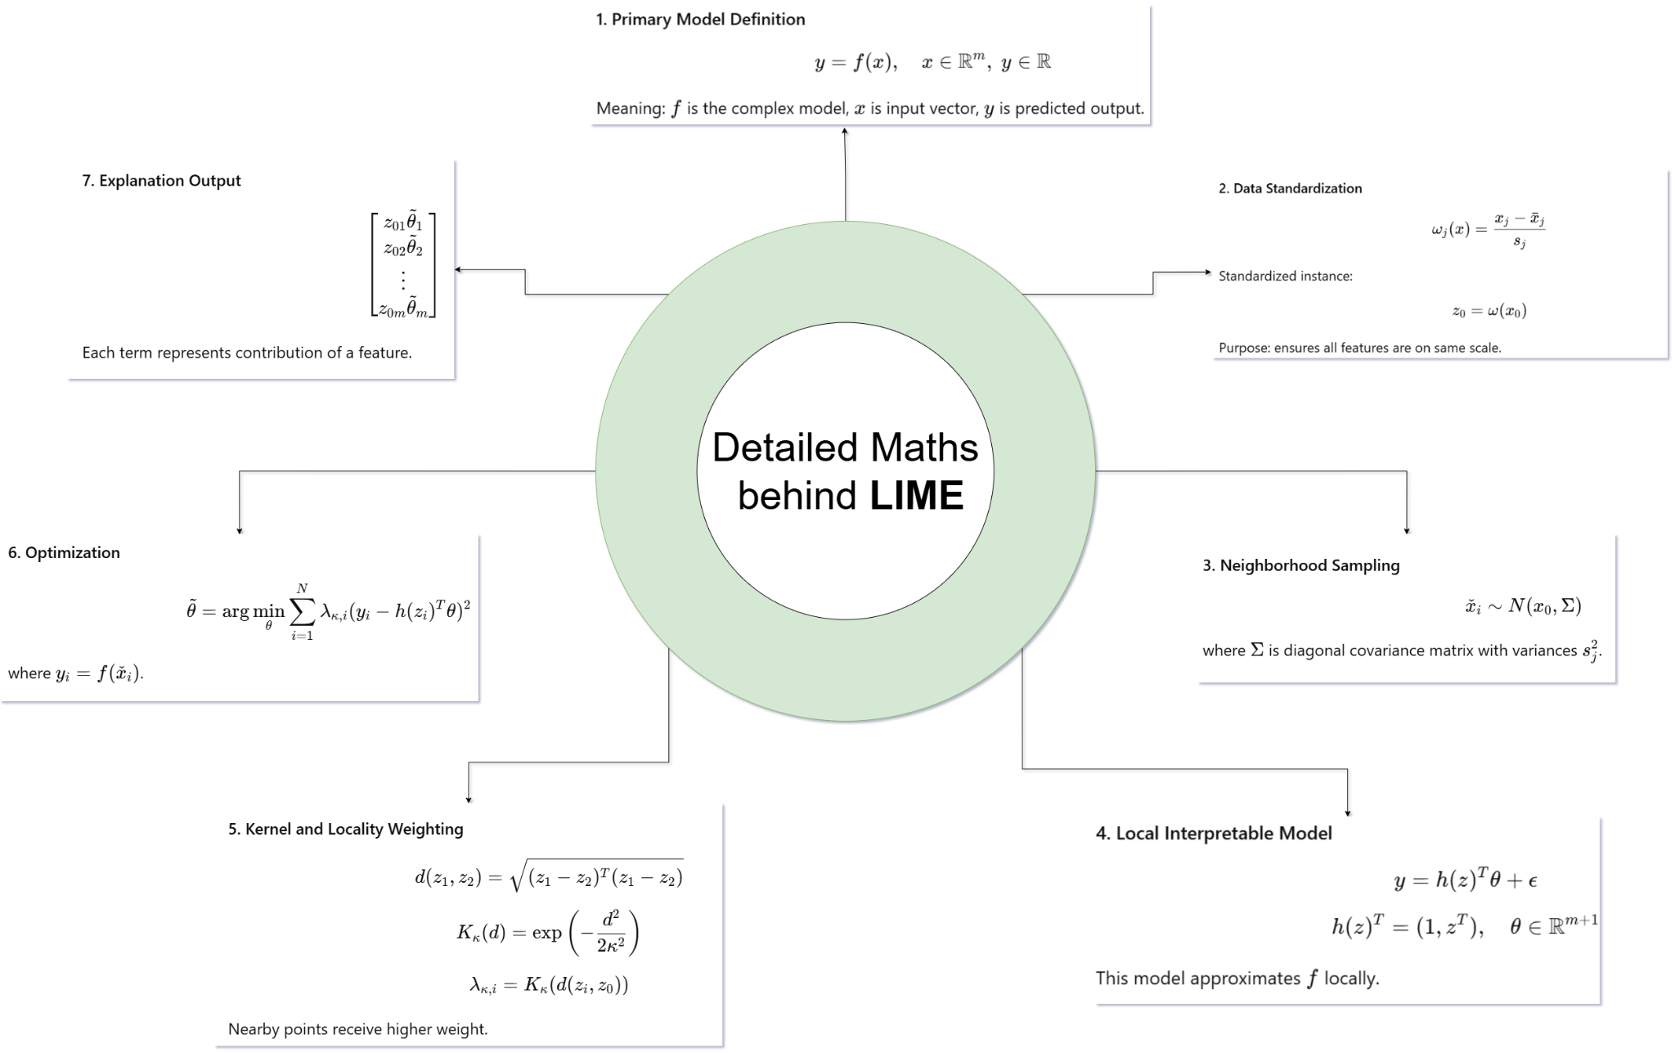

Slide 6
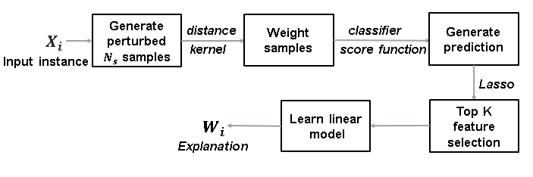
LIME Mind-Map

Slide 7
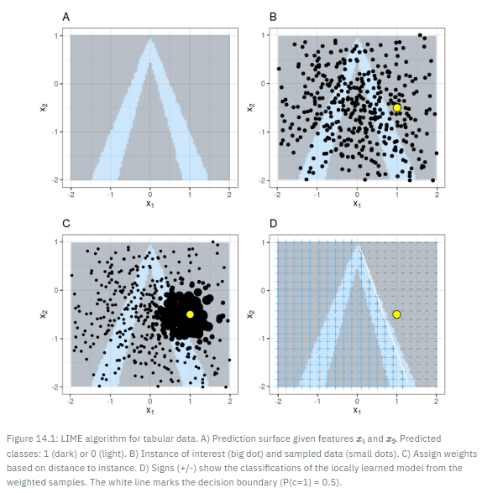
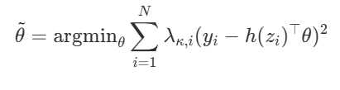
Weighted Least Squares for Explanation
Locality Weighting (λκ,i): Each sampled point is assigned a weight based on its distance from x_0. Nearby points get higher weights, distant points get lower weights, ensuring a local explanation.
Optimization Goal: Find θ by minimizing the weighted squared error between primary model predictions and secondary model outputs:

Slide 8


Interpretation of LIME Coefficients
LIME coefficients represent the contribution of each feature to the prediction of the instance x_0.
Each coefficient shows the local effect of a feature. A positive value increases the prediction, while a negative value decreases it.
Larger absolute values ∣ ∣ indicate more influential features, allowing feature importance ranking.
These coefficients are valid only near x_0​ and do not describe the global behavior of the model.
Mathematical Representation:
This vector represents the feature-wise contribution to the prediction.

Slide 9
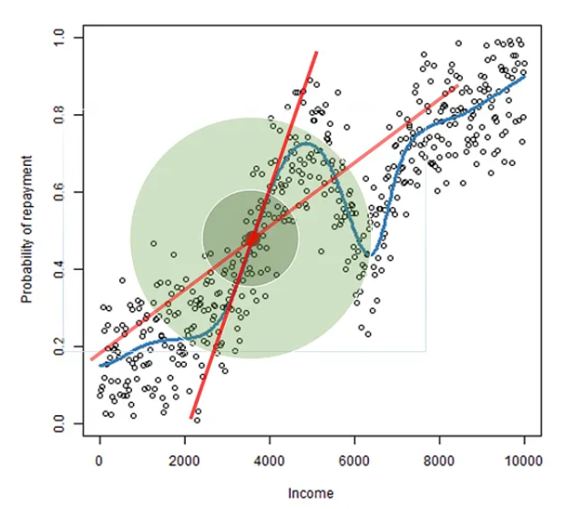


Random Sampling from Multivariate Normal Distribution
Sampling Distribution: Synthetic points are generated from a multivariate normal distribution:
Center (x_0: The distribution is centered at the instance of interest x_0​, ensuring samples lie in its local neighborhood.
Covariance Matrix (Σ): Σ is a diagonal matrix with entries (sj)^2, the variances of training features values, which control the spread of sampling.
Feature Independence: Since Σ is diagonal, feature values are sampled independently. Sampled points are passed through the primary model to create a local dataset for training the surrogate model.
Drawbacks: Random sampling can cause instability and inefficiency, as distant samples may receive very low weights and not contribute to the explanation.

Slide 10
Why covariance matrix is diagonal in LIME?
What if it is not?
Variance of Training Features in LIME: Variance refers to how much the feature values vary in the training data. LIME uses this variance to sample new values around the instance 𝑥_0, keeping samples realistic and close to the original data distribution.
How much variance should be used: Variance should be moderate. Too large can make samples go far from instance, losing local behavior and too small can make the samples too close, failing to capture feature influence properly.
Why Covariance Matrix is Diagonal in LIME: A diagonal covariance matrix assumes features are independent, allowing LIME to vary each feature separately and measure its individual effect clearly. Assuming features are independent means LIME changes one feature at a time without considering its relationship with other features during sampling.
If covariance is not diagonal: Features become correlated during sampling, making it difficult to isolate and interpret the individual contribution of each feature.
Note: In real dataset, features may be correlated, so independent sampling can sometimes create unrealistic samples.

Slide 11
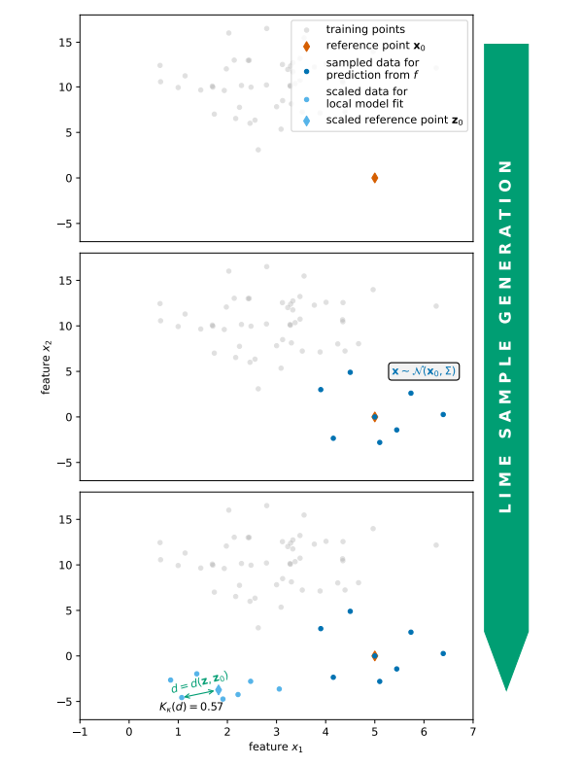
LIME: Pictorial Explanation

Slide 12
How LIME can be improved?
Sampling strategy
Replace purely random sampling with more informative and structured sampling.
Improve coverage of the local neighborhood to produce more reliable surrogate models.
Distance measurement and locality definition
Use learned embeddings (e.g., via autoencoders) instead of raw input space.
Provides a more meaningful notion of similarity between instances.
Kernel width selection
Optimize kernel width rather than relying on fixed heuristics.
Ensures a better balance between locality and explanation stability.
Adaptive sample size determination
Dynamically adjust the number of samples based on explanation stability.
Reduces unnecessary computation while maintaining explanation reliability.

Slide 13
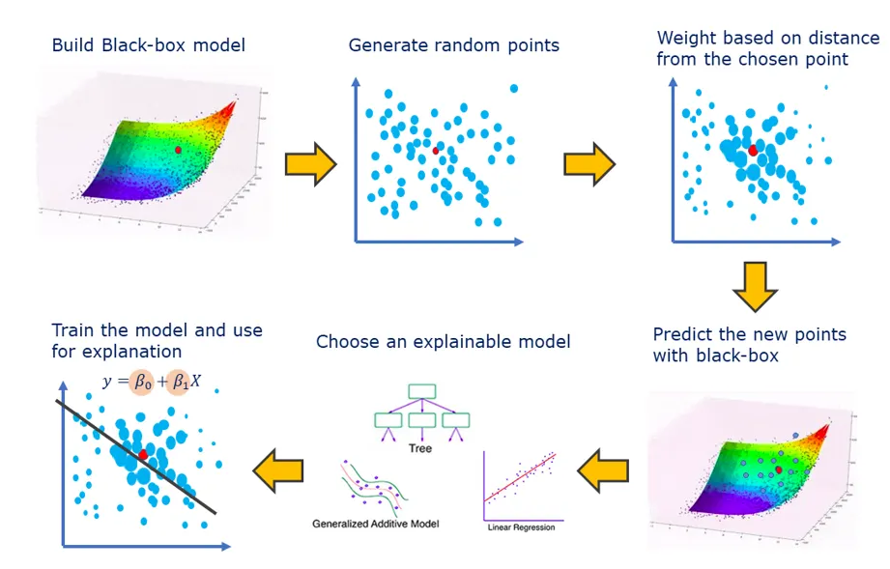
Problem: Computational Cost and Inefficiency of LIME
LIME explains predictions using local linear models.
But LIME requires:
Many sampled points
Many model evaluations
This leads to:
High computational cost
High energy consumption
Slow explanations

Slide 14
Problem: Instability of LIME
Instability in LIME refers to the fact that the method leads to different results for multiple runs of the algorithm.
Why does this happen?
sampling of neighborhood data is completely random, hence the training data for the interpretable secondary model is different at each run.
For example:
A variable could for example positively affect the prediction in one run and have a negative impact in another run.
Consequence:
Less trust in the model even though the main proposed purposes of LIME is to increase trust in a model

Slide 15
Problem: Excessive Model Evaluations
LIME requires evaluating many sampled instances, including irrelevant ones, which increases computational cost, runtime, and energy consumption.
Why does this happen?
Many sampled instances are far from the instance of interest
These instances have near-zero locality weight and they provide little or no useful information for the local surrogate model
Despite this, the prediction function f must still be evaluated
For example:
An explanation may require thousands of model evaluations (e.g., 5000 samples)
Each evaluation adds computational cost, especially if the prediction function is expensive
Consequence:
Increased computational runtime and energy consumption
Higher deployment cost due to repeated inference
Reduced efficiency, especially in real-time explanation scenarios

Slide 16
Key Idea: Using Optimal Design to Improve LIME
Goal:
Reduce number of samples
maintaining explanation quality
Solution:
Use Optimal Design of Experiments
Key principle:
Maximize information
Minimize variance
Key Words: samples, explanation quality, optimal design, information, variance

Slide 17
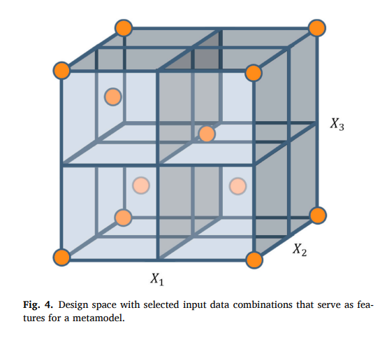
Introduction to Optimal Design of Experiments
Optimal Design of Experiments (ODE) is a statistical approach focused on maximizing information from limited observations. It Improves data collection efficiency under constraints like computational resources.
It is Used in LIME to optimize selection of sample points for approximating the primary model with an interpretable secondary model. Strategically selected samples reduce primary model evaluations, lowering computational cost and energy consumption.
It enhances the Stability as it provides fixed support points, reducing variability and improving stability compared to random sampling in LIME.
Key-word: D-Optimal Design
The cube represents the design space of features (𝑋1, 𝑋2, 𝑋3). The orange boundary points represent optimally selected support points using Optimal Design (D-optimal design).

Slide 18
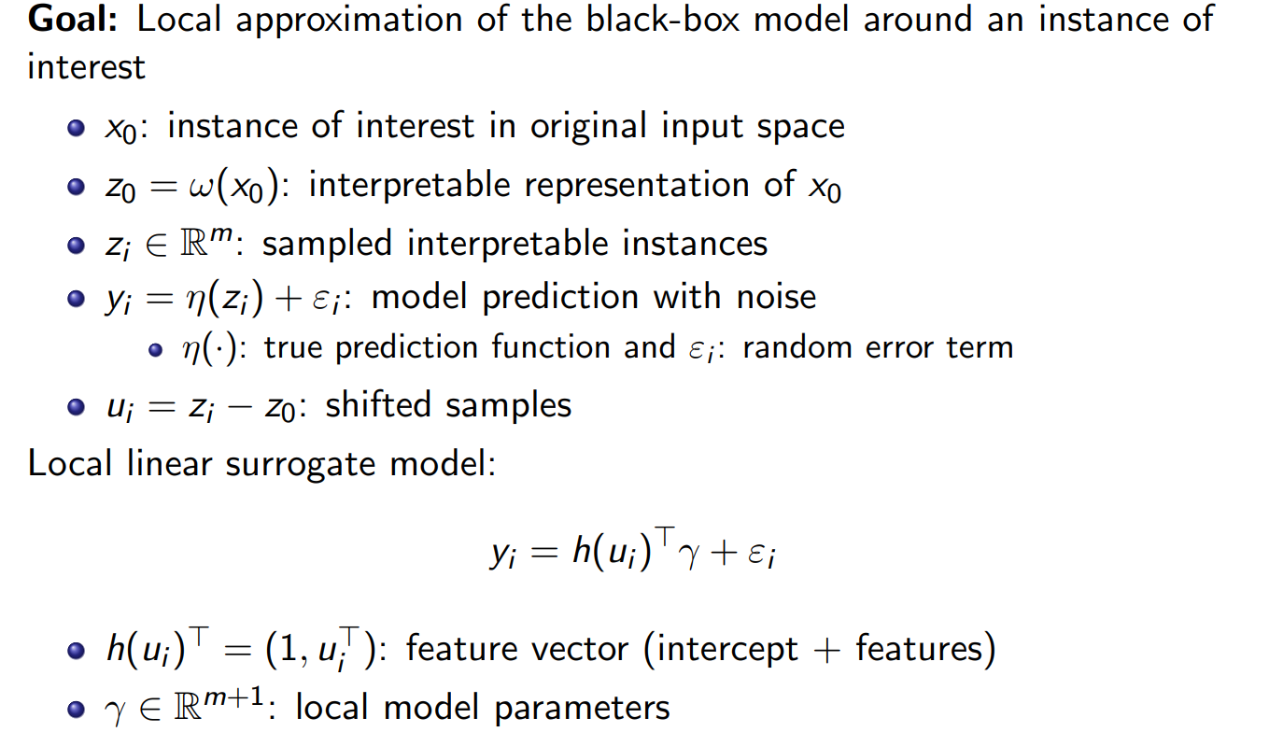
Model Setup and Notation

Slide 19
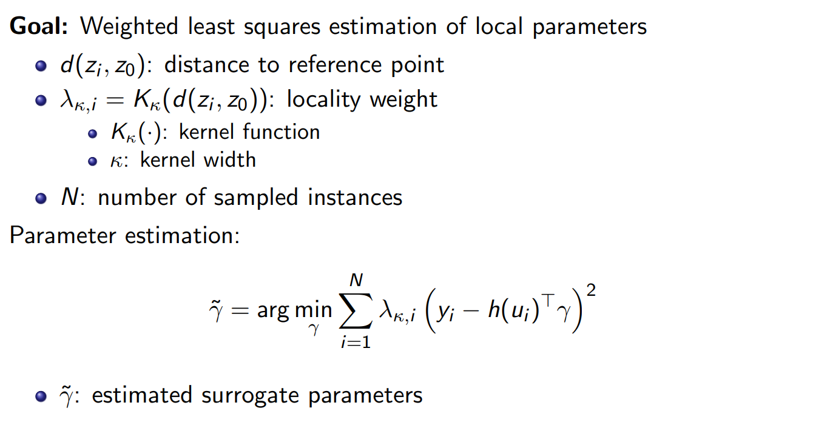
Parameter Estimation

Slide 20
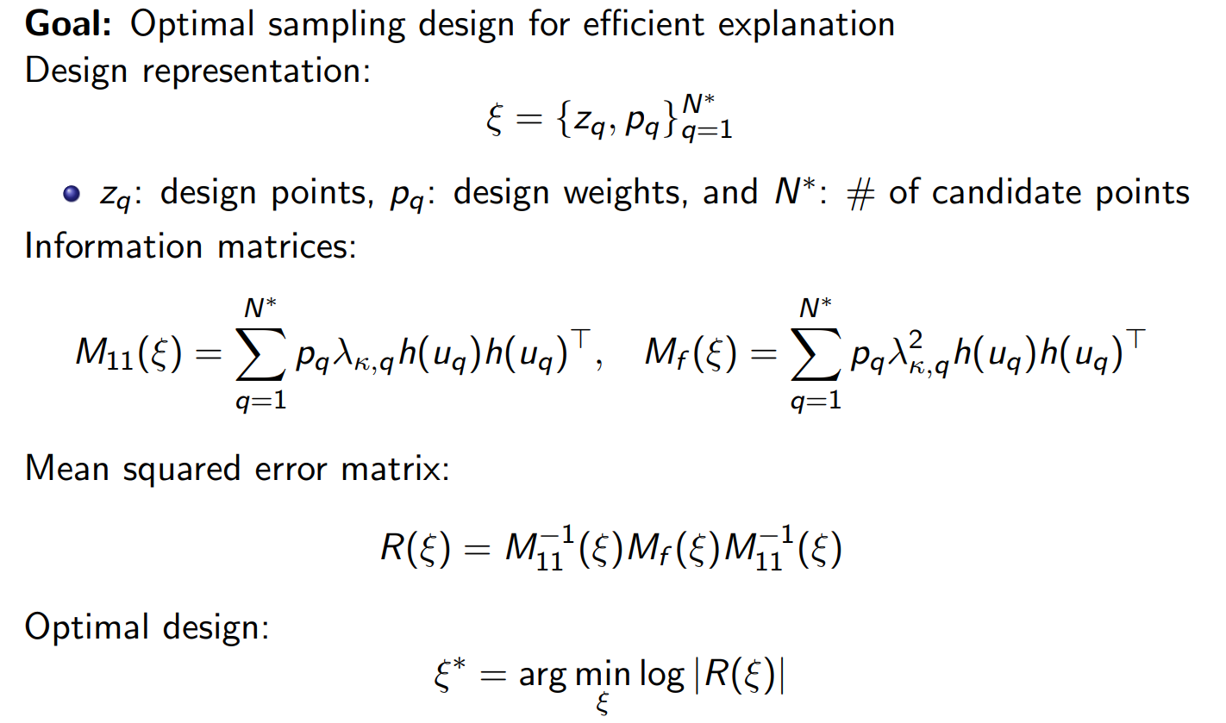
Design and Optimality Criterion

Slide 21
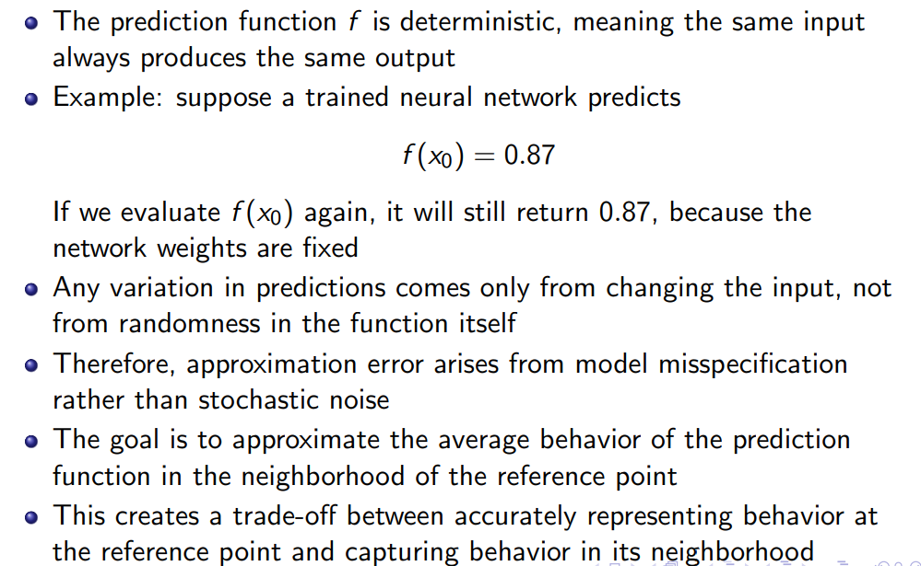
Approximation Goal

Slide 22
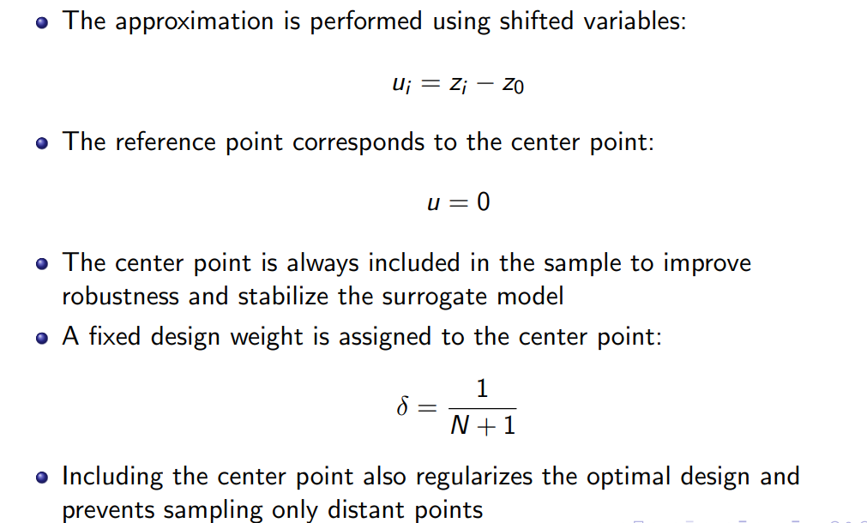
Importance of the Center Point

Slide 23
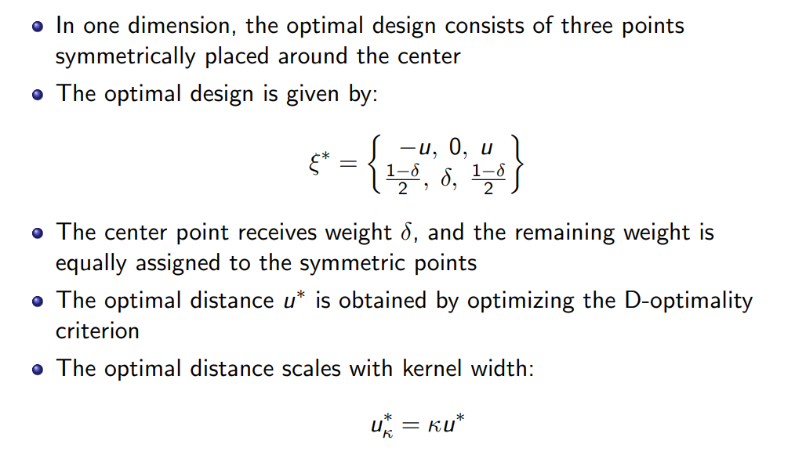
Structure of the D-opt Design

Slide 24
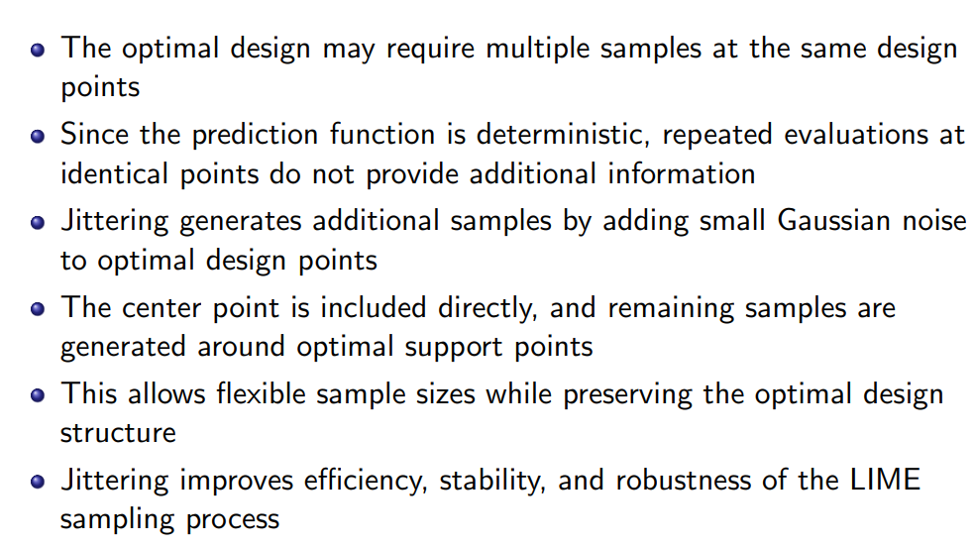
Jittering for Practical Sample

Slide 25
Jittering for Practical Sample

Slide 26
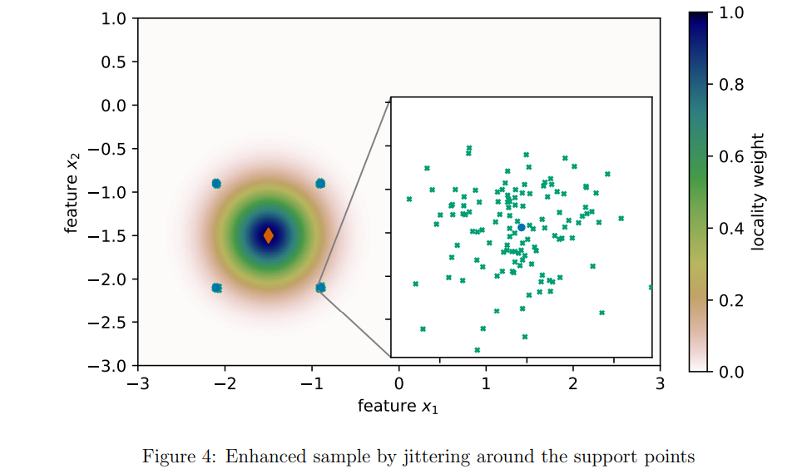
Green-LIME Example

Slide 27
Green-LIME Example (contd.)
The reference point is shown as a red diamond. Nbd is defined using Euclidean distance and the RBF kernel.
The optimal design consists of support points (shown in blue) symmetrically surrounding the reference point (support pts with their locality weight ~ 1/18).
The total sample size is 501 points.
One sample is assigned to the reference point. And, four samples correspond to the optimal design support points.
The remaining 496 samples are allocated to the support points proportional to their design weights.
These additional samples are generated by adding Gaussian noise with mean 0 and variance 0.01^2 from the support points (jittering).

Slide 28
Conclusion
Optimal design of experiments improves LIME by replacing random sampling with structured, informative sampling.
The proposed method reduces the number of model evaluations while maintaining comparable explanation quality.
This leads to improved computational efficiency and lower energy consumption.
The approach is currently for tabular data and regression setting.
Optimal design provides a principled framework for efficient data collection in explainable AI

Slide 29
Future Directions
Extend optimal design methods to higher-dimensional feature spaces using more efficient design constructions.
Incorporate feature selection methods, such as penalized regression (e.g., Lasso), into the optimal design framework.
Improve robustness by sampling from realistic data distributions rather than artificial perturbations.
Develop joint optimal designs that generate explanations efficiently for multiple reference points.

